Slide 1
虛擬化技術 Virtualization Technique
System Virtualization
I/O Virtualization

Slide 2
Agenda
Overview
Background knowledge of I/O subsystem
Introduction to I/O virtualization
Device Model
Optimization: Virt-I/O
Introduction to Virt-IO
Architecture of Virt-IO
Important Operations
Hardware Assistant

Slide 3
Overview
Background knowledge of I/O subsystem
Introduction to I/O virtualization

Slide 4
IO Virtualization
Goal :
Share or create I/O devices for virtual machines.
Two types of IO subsystem architecture :
Port Mapped IO (PMIO)
Port-mapped IO uses a special class of CPU instructions specifically for performing IO.
Memory Mapped IO (MMIO)
Memory Mapped IO uses the same address bus to address both memory and IO devices, and the CPU instructions used to access the memory are also used for accessing devices.
Traditional IO techniques :
Direct memory Access (DMA)
PCI / PCI Express

Slide 5
Port Mapped IO
IO devices are mapped into a separate address space
IO devices have a separate address space from general memory, either accomplished by an extra “IO" pin on the CPU's physical interface, or an entire bus dedicated to IO.
Generally found on Intel microprocessors, specifically the IN and OUT instructions which can read and write one to four bytes (outb, outw, outl) to an IO device.
Pros & Cons
Pros
Less logic is needed to decode a discrete address.
Benefits for CPUs with limited addressing capability.
Cons
More instructions are required to accomplish the same task.
IO addressing space size is not flexible.

Slide 6
Memory Mapped IO
IO devices are mapped into the system memory map along with RAM and ROM.
To access a hardware device, simply read or write to those 'special' addresses using the normal memory access instructions.
Each I/O device monitors the CPU's address bus and responds to any CPU access of an address assigned to that device, connecting the data bus to the desired device's hardware register.
Pros & Cons
Pros
Instructions which can access memory can be used to operate an IO device.
Operate on the data with fewer instructions.
Cons
Physical memory addressing space must be shared with IO devices.
The entire address bus must be fully decoded for every device.

Slide 7
Direct Memory Access
What is DMA ?
DMA is a memory-to-device communication method that bypasses the CPU.
Allow certain hardware subsystems within the computer to access system memory for reading and/or writing independently of the CPU.
Two types of DMA
Synchronous DMA
The DMA operation is caused by software.
For example, sound card driver may trigger DMA operation to play music.
Asynchronous DMA
The DMA operation is caused by devices (hardware).
For example, network card uses DMA operation to load data into memory and interrupts CPU for further manipulation.

Slide 8
PCI & PCI Express
What is PCI ?
PCI (Peripheral Component Interconnect) is a computer bus for attaching hardware devices.
Typical PCI cards used include :
Network cards, sound cards, modems
Extra ports such as USB or serial, TV tuner cards and disk controllers.
What is PCI Express ?
PCIe is a computer expansion card standard designed to replace the older PCI, PCI-X, and AGP standards.
Its topology is based on point-to-point serial links, rather than a shared parallel bus architecture.

Slide 9
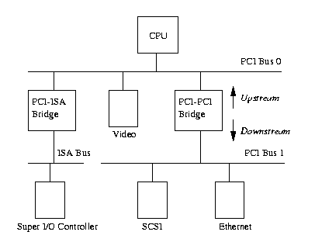
PCI & PCI Express
PCI based system build in a tree topology
PCI bus
Parallel connect devices and bridges
PCI-PCI Bridge
Connect two PCI buses
Become the root of lower bus
PCI-ISA Bridge
Connect to conventional ISA device

Slide 10
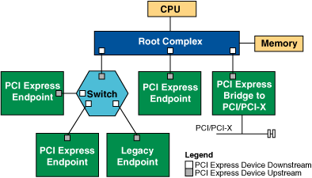
PCI & PCI Express
PCIe based system build in a point to point architecture
Root Complex
Similar to a host bridge in a PCI system, the root complex generates transaction requests on behalf of the processor, which is interconnected through a local bus.
Switch
Connect endpoint devices or other switches
Endpoint Device
Physical PCIe devices
Legacy PCI devices
PCI Express Bridge
Connect to other legacy subsystems

Slide 11
Overview
Background knowledge of I/O subsystem
Introduction to I/O virtualization

Slide 12
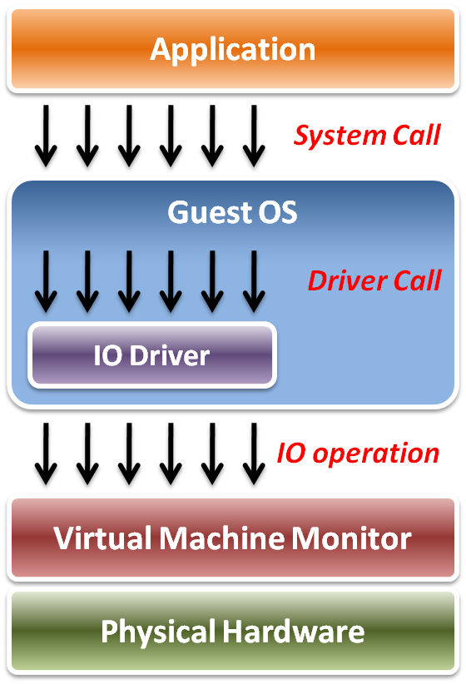
IO Virtualization
Implementation Layers :
System call
The interface between applications and guest OS.
Driver call
The interface between guest OS and IO device drivers.
IO operation
The interface between IO device driver of guest OS and virtualized hardware ( in VMM ).

Slide 13
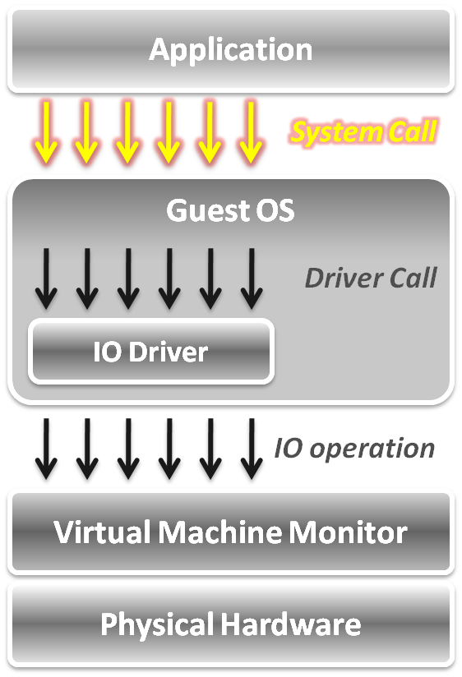
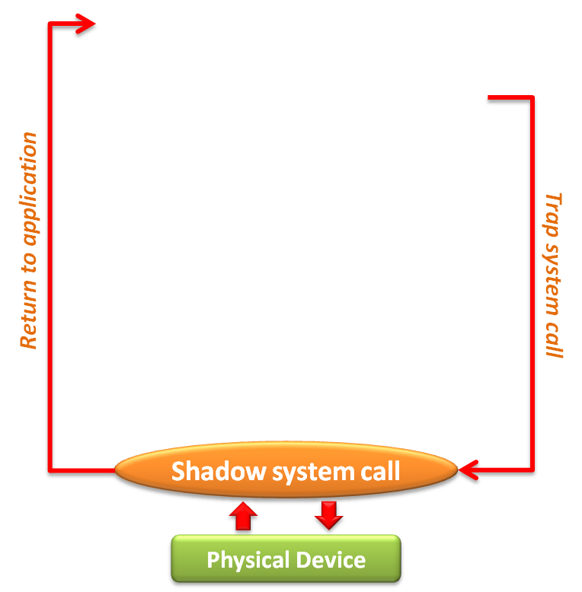
IO Virtualization
In system call level :
When an application invokes a system call, the system call will be trapped to VMM first.
VMM intercepts system calls, and maintains shadowed IO system call routines to simulate functionalities.
After simulation, the control goes back to the application in gust OS.

Slide 14
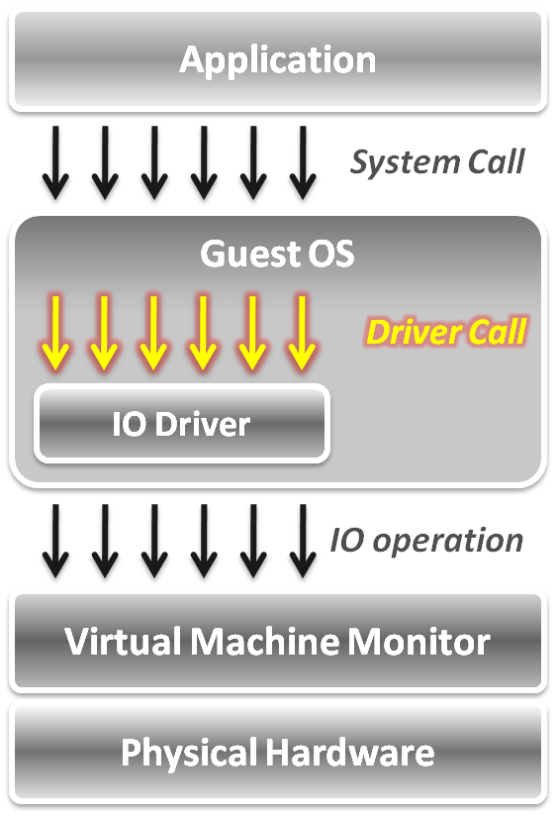
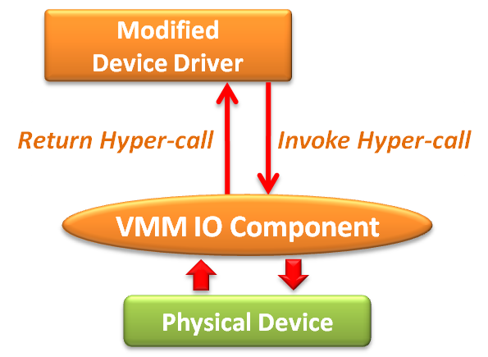
IO Virtualization
In device driver call level :
Adopt the para-virtualization technique, which means the IO device driver in guest OS should be modified.
The IO operation is invoked by means of hyper-call between the modified device driver and VMM IO component.

Slide 15
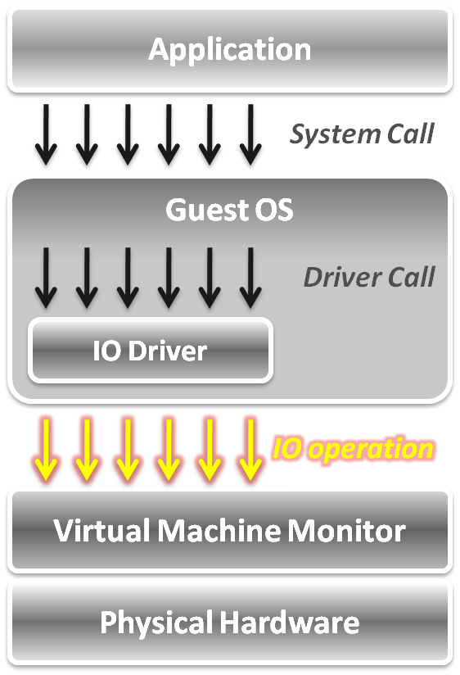
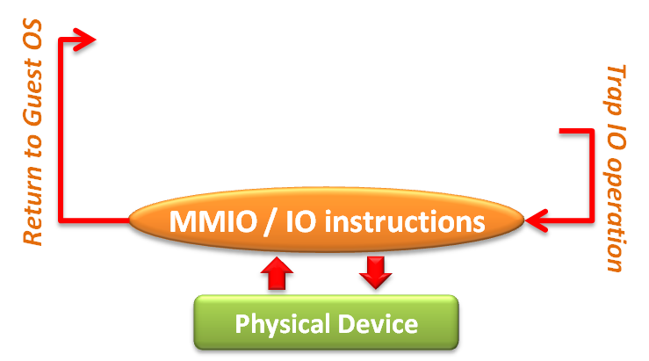
IO Virtualization
In IO operation level,
Port mapped IO
Special input/output instructions with special addresses.
The IO instructions are privileged .
Memory mapped IO
Loads/stores to specific region of real memory are interpreted as command to devices.
The memory mapped IO region is protected.
Due to the privileged nature, these IO operations will be trapped to the VMM.

Slide 16
Device model

Slide 17
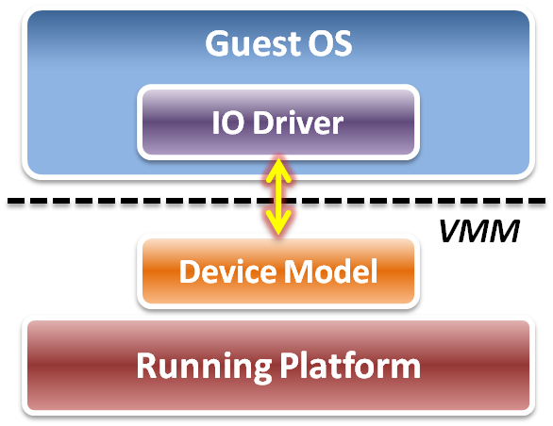
Device Model
Focus on IO operation level implementation.
This is an approach of full virtualization.
Logic relation between guest OS and VMM :
VMM intercepts IO operations from guest OS.
Pass these operations to device model on a running platform.
Device model needs to emulate the IO operation interfaces.
Port mapped IO
Memory mapped IO
DMA
... etc.

Slide 18
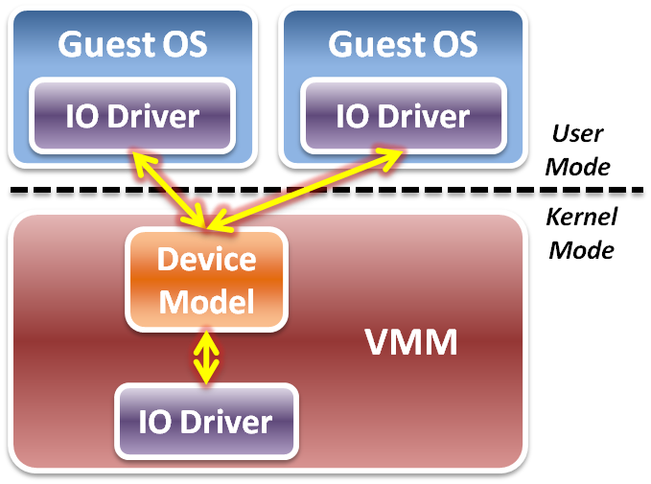
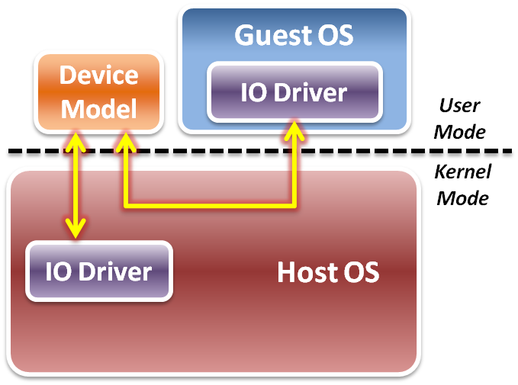
Device Model
Two different implementations of device model :
Device model is implemented as part of VMM.
Device model is running in user space as a stand alone service.
Type 1 Virtualization
Type 2 Virtualization

Slide 19
Device Model
IO virtualization flow
Initialization – device discovery
VMM will make guest OS discover the virtualized IO devices.
Then guest OS will load the corresponding device driver.
Operation – access interception
When guest OS executes IO operations, VMM will intercept those accesses.
After virtual device operations, VMM returns the control to guest OS.
Virtualization – device virtualization
Device model should emulate the real electronic logic to satisfy all device interface definitions and their effects.
VMM may share physical devices to all virtual machines.

Slide 20
Device Discovery
Virtualize physical bus devices
Non-enumerable physical devices
These devices have their own hard-coded numbers.
VMM should setup some status information on the virtual device ports.
For example, PS/2 keyboard and mouse.
Enumerable physical devices
These devices define a complete device discover method.
VMM have to emulate not only the devices themselves, but the bus behavior.
For example, PCI or PCI express devices.
Virtualize non-exist devices
VMM must define and emulate all functions of these devices
VMM may define them as either non-enumerable or enumerable devices.
Guest OS needs to load some new drivers of these virtual devices.

Slide 21
Access Interception
After virtual devices discovered by guest OS, VMM has to intercept and control all the IO operations from guest OS.
Port mapped IO operation
Direct device assignment
VMM should turn ON the physical IO bitmap.
All the IO instructions (IN/OUT) from guest OS will be directly performed onto hardware without VMM intervention.
Indirect device assignment
VMM should turn OFF the physical IO bitmap.
All the IO instructions from guest OS will be intercepted by VMM and forward to physical hardware.

Slide 22
Access Interception
Memory mapped IO operation
Direct device assignment
VMM should use the shadow page table to map IO device addressing space of guest OS to the space of host.
Then all the IO operations from guest OS will not be intercepted.
Indirect device assignment
VMM should make the all entries of the IO device addressing space in the shadow page table to be invalid.
When guest OS accesses those addressing space, it will introduce the page fault which trap CPU to VMM for device emulation.
DMA mechanism
Address remapping
Because the device driver in the guest OS does not know the host physical address, VMM needs to remap the DMA target automatically when intercepting IO operations from guest OS.

Slide 23
Device Virtualization
IO device types :
Dedicated device
Ex : displayer, mouse, keyboard …etc.
Partitioned device
Ex : disk, tape …etc
Shared device
Ex : network card, graphic card …etc.
Nonexistent physical device
Ex : virtual device …etc.

Slide 24
Device Virtualization
Dedicated device
Do not need to be virtualized.
In theory, requests of such device could bypass the VMM.
However, they are handled by the VMM first since OS is running in user mode.
Partitioned device
Partitioned into several smaller virtual devices as dedicated to VMs.
VMM translates address spaces to those of the physical devices.

Slide 25
Device Virtualization
Shared device
Should be shared among VMs.
Each VM has its own virtual device state.
VMM translates a request from a VM to a physical device .
Nonexistent physical device
Virtual device “attached” to a VM for which there is no corresponding physical device.
VMM intercepts requests from a VM, buffers them and interrupts other VMs.

Slide 26
Performance Issues
When considering performance, two major issues :
How to make guest OS directly access IO addresses ?
Other than software approaches discussed above, we can make use of the hardware assistance (Intel EPT technique in memory virtualization) to map IO addresses from host to guest directly without software overhead.
How to make DMA directly access memory space in guest OS ?
For the synchronous DMA operation, guest OS will be able to assign the correct host physical memory address by EPT technique.
For the asynchronous DMA operation, hardware must access memory from host OS which will introduce the VMM intervention.

Slide 27
optimization: virt-io
Introduction to Virt-IO
Architecture of Virt-IO
Important Operations

Slide 28
Overview
Device Emulation Environment
Full virtualization
Para-virtualization

Slide 29
What is virtio
Virtio is a Linux IO virtualization standard for network and disk device drivers and cooperates with the hypervisor.
It provides a set of APIs and structures for making virtio devices.
The host implementation is in userspace - qemu, so no driver is needed in the host
Only the guest's device drivers aware the virtual environment.
This enables guests to get high performance network and disk operations, and gives most of the performance benefits of para-virtualization.

Slide 30
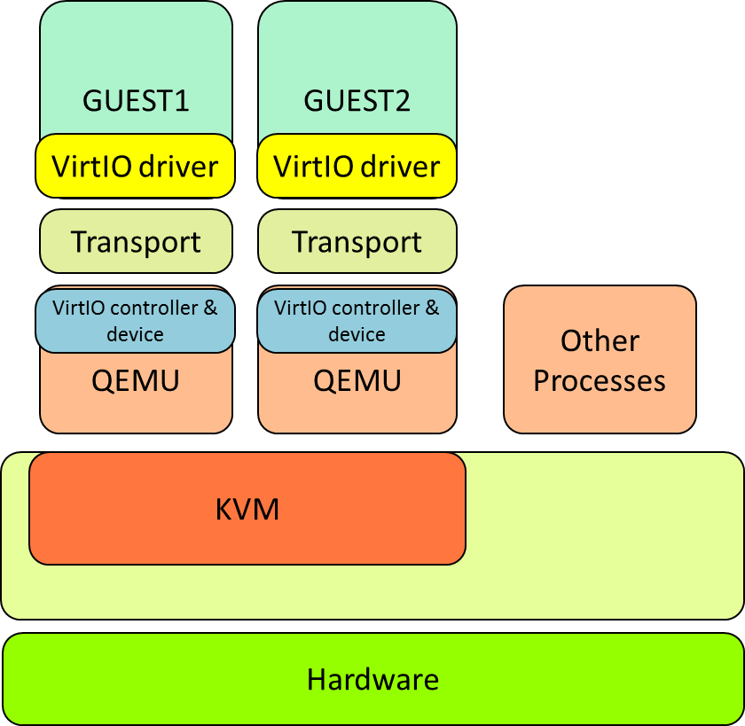
Why it fast
A part of memory space (Virtqueue) are shared between guests and QEMU to accelerate the data accessing by each sides.
Reduce the number of MMIOs.

Slide 31
optimization: virt-io
Introduction to Virt-IO
Architecture of Virt-IO
Important Operations

Slide 32
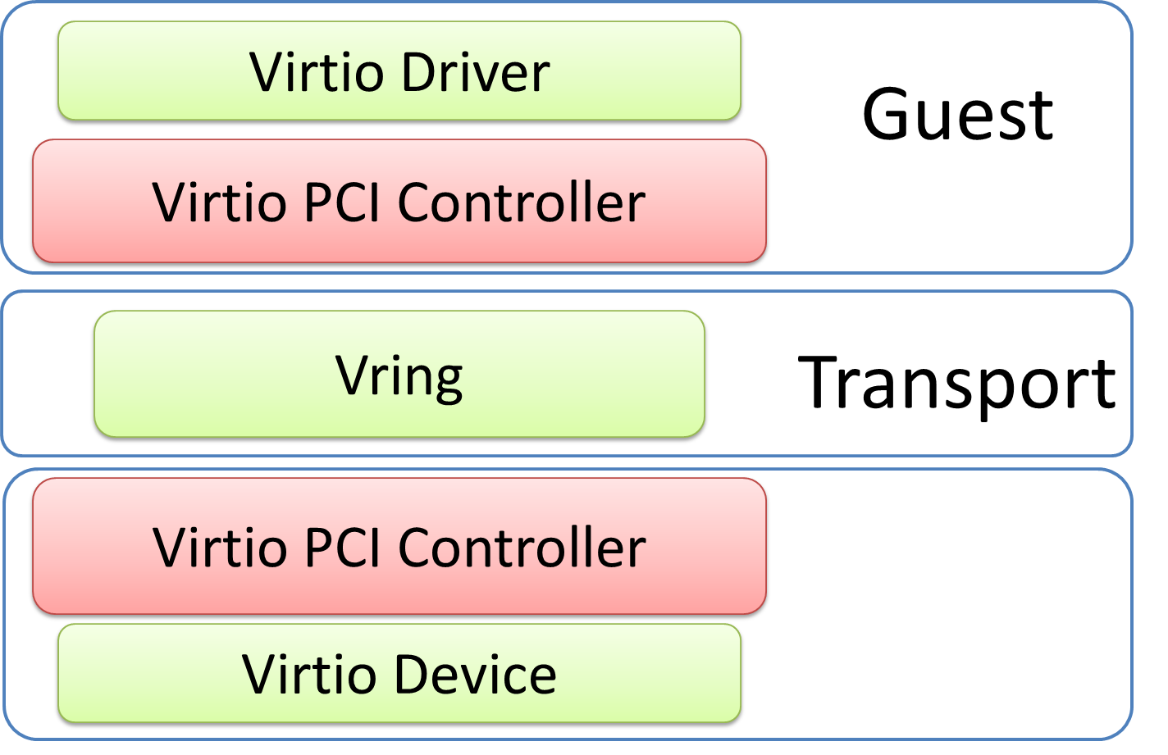
Architecture of Virt-IO
Front-end driver
Virtqueue
Virtio-buffer
Back-end driver
QEMU

Slide 33
Driver
Front-end driver
A kernel module in guest OS.
Accepts I/O requests from user process.
Transfer I/O requests to back-end driver.
Back-end driver
A device in QEMU.
Accepts I/O requests from front-end driver.
Perform I/O operation via physical device.

Slide 34
Transport
Virtual queue called virtqueue
It is a part of memory of the guest.
A channel between front-end and back-end.
Implemented as rings called Vring to traverse the guest-to-hypervisor transition.
Vring is a memory mapped region between QEMU & Guest
Vring is the memory layout virtqueue
Virtio-buffer
Buffer to put send/receive requests.
Represented as a scatter-gather list.

Slide 35
KVM without Virt-IO
GUEST
Guest Application
Driver
IO controller & device
QEMU
Other
Processes
Device driver
KVM
Host
Host
Hardware

Slide 36
KVM with Virt-IO
GUEST1
VirtIO driver
Transport
QEMU
Other
Processes
VirtIO controller & device
KVM
Device driver
Host
Hardware

Slide 37
optimization: virt-io
Introduction to Virt-IO
Architecture of Virt-IO
Important Operations

Slide 38
Virtqueue Initialization
Find virtqueue
Virtio Driver
Guest
Virtio PCI Controller
Alloc Vring
Vring
Transport
Virtio PCI Controller
Vring GPA
QEMU
Virtio Device

Slide 39
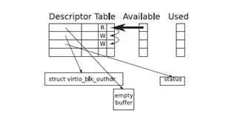

Virtqueue Data Structure
Virtio Driver
Guest
Virt queue Write
Virt queue Read
Vring
Vring
QEMU
Virtio Device

Slide 40
Data Exchange APIs
In guest
virtqueue_add_buf
Expose virtio-buffer to other end
virtqueue_get_buf
Get the results from virtqueue
virtqueue_kick
Update virtqueue after add_buf
Notify QEMU to deal with the data
In QEMU
virtqueue_pop
Pop the data from virtqueue
virtqueue_push
Put data back to virtqueue

Slide 41
Data Exchanging Flow
Virtio Driver
Guest
Add Buf
Virt queue Write
Virt queue Read
Vring
Vring
In
Out
data
Virtio Device
QEMU

Slide 42
Data Exchanging Flow
Kick
Virtio Driver
Guest
Virt queue Write
Virt queue Read
Vring
Vring
In
Out
data
Virtio Device
QEMU

Slide 43
Data Exchanging Flow
Virtio Driver
Guest
Virt queue Write
Virt queue Read
Vring
Vring
In
Out
data
POP
Virtio Device
QEMU

Slide 44
Data Exchanging Flow
Virtio Driver
Guest
Virt queue Write
Virt queue Read
Vring
Vring
In
Out
data
Push
Virtio Device
QEMU

Slide 45
Data Exchanging Flow
Virtio Driver
Guest
Get Buf
Virt queue Write
Virt queue Read
Vring
Vring
In
data
Out
Virtio Device
QEMU

Slide 46
Call Back APIs
In guest
virtqueue_disable_cb
Disable callbacks
Need not necessarily synchronous
Unreliable and only useful as an optimization
virtqueue_enable_cb
Restart callbacks after virtqueue_disable_cb

Slide 47
Hardware assistant

Slide 48
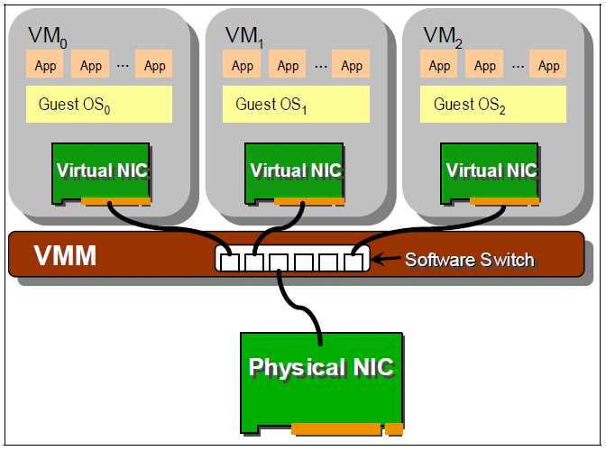
Software IO Virtualization
Software based sharing
Implement virtualization by VMM software stack.
Advantage
Full virtualization without special hardware support.
Disadvantage
Significant CPU overhead may be required by the VMM.
Software cannot make data access directly from devices.

Slide 49
Hardware Solution
Tow hardware solutions :
Implement DMA remapping in hardware
Remap DMA operations automatically by hardware.
For example, Intel VT-d .
Specify IO virtualization standards of PCI Express devices
Implement virtualizable device with PCI Express interface.
For example, SR-IOV or MR-IOV.

Slide 50
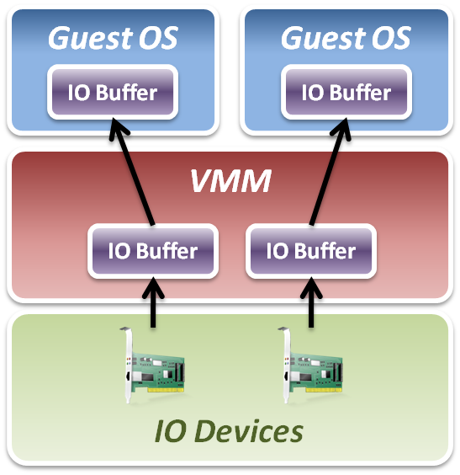
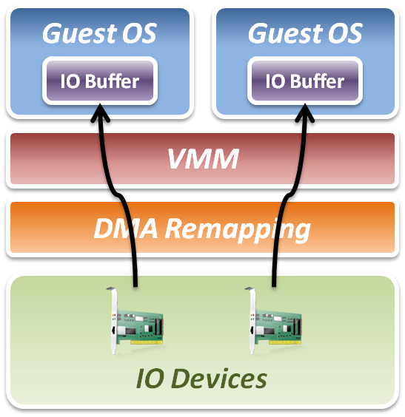
Intel VT-d
Add DMA remapping hardware component.
Software Approach
Hardware Approach

Slide 51
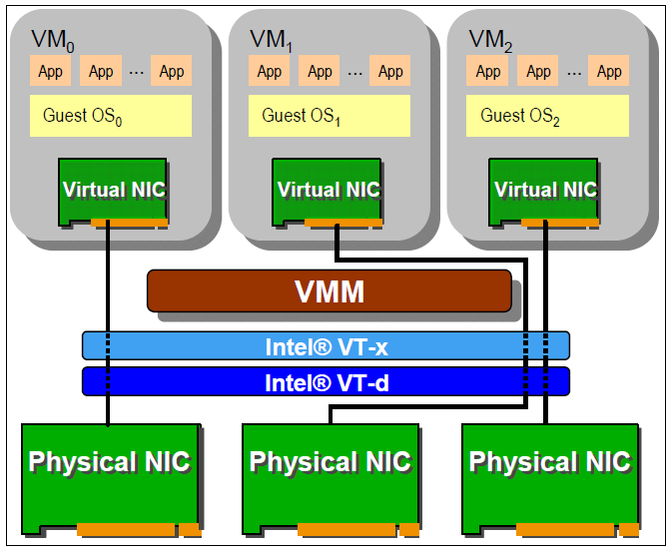
Intel VT-d
Advantages
Data access bypass VMM.
Improve IO performance.
Disadvantages
Dedicate physical device assignment limit the system scalability.

Slide 52
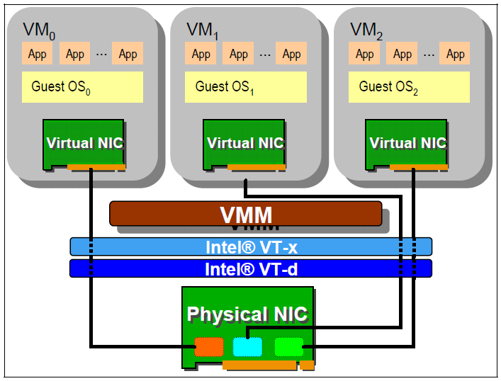
Single Root – IO Virtualization
New industrial standard
Instead of implementing virtualization in CPU or memory only, industry comes up with new IO virtualization standard in PCI Express devices.
Advantages
Fully collaboration with physical hardware devices.
Improve system scalability.
Improve system agility.
Disadvantages
IO devices must implement with new specification.

Slide 53
Single Root – IO Virtualization
What is SR-IOV ?
The PCI-SIG Single Root I/O Virtualization and Sharing (SR-IOV) specification defines a standardized mechanism to create natively shared devices.
Basic components :
Physical Functions (PFs)
These are full PCIe functions that include the SR-IOV Extended Capability.
The capability is used to configure and manage the SR-IOV functionality.
Virtual Functions (VFs)
These are “lightweight” PCIe functions that contain the resources necessary for data movement but have a carefully minimized set of configuration resources.

Slide 54
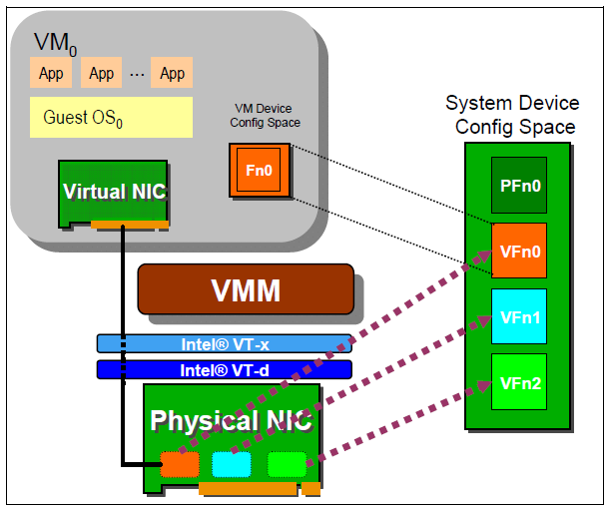
Single Root – IO Virtualization
SR-IOV works with VMM :
VMM
An SR-IOV-capable device can be configured to appear in the PCI configuration space as multiple functions.
VM
The VMM assigns one or more VFs to a VM by mapping the actual configuration space of the VFs to the configuration space presented to the virtual machine by the VMM.

Slide 55
References
Web resources :
IBM VirtIO survey https://www.ibm.com/developerworks/linux/library/l-virtio
Virtio: An I/O virtualization framework for Linux http://www.ibm.com/developerworks/linux/library/l-virtio/index.html?ca=dgr-lnxw97Viriodth-LX&S_TACT=105AGX59&S_CMP=grlnxw97
virtio: Towards a De-Facto Standard For Virtual IO Devices http://www.tdeig.ch/kvm/pasche/32_virtio_Russel.pdf
PCI-SIG IO virtualization specification http://www.pcisig.com/specifications/iov
Paper & thesis resources :
林長融，ARMvisor IO 效能最佳化及分析，以 Virtio 及 irqchip 為例，國立清華大學，碩士論文，2012
Source code:
Linux Kernel http://kernel.org
QEMU http://wiki.qemu.org
Other resources :
Lecture slides of “Virtual Machine” course (5200) in NCTU
Lecture slides of “Cloud Computing” course (CS5421) in NTHU

